Slide 1
ENGINEERING AS SOCIAL EXPERIMENTATION

Slide 2
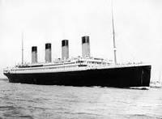

TITANIC

Slide 3
GREATEST ENGINEERING ACHIEVEMENT
The ship TITANIC in April1912 was the largest ship the world had ever seen
Length: 2 and ½ times foot ball field length.
Capacity: 3500 passengers and crew
No. of passengers travelling: 2500
Accident due to iceberg
Iceberg tore a large gap in the ship’s side directly flooding five compartments out of 60 compartments
No. of passengers survived:1000
Lack of required life boats, provision of safe exit
All products of technology present some dangers and thus engineering is a risk activity

Slide 4
STEPS IN MAKING A PRODUCT
Experimentation plays an important role in the design process. Preliminary tests are conducted from beginning of the product
Engineering Concept
Rough Design
Detailed Design
Production Stage tests
Finished product
Each engineering project is viewed as an experiment

Slide 5
Process
Engineering Projects are to be viewed as Engineering experiments
First any project is carried out in partial ignorance
Second the final outcomes are uncertain
Third is knowledge gained about the products
Learning through past experiences and sharing with other engineers

Slide 6
FEATURES OF MORALLY RESPONSIBLE ENGINEERS
Conscientiousness-Conscious about welfare
Relevant information-Know the details
Moral autonomy-Morals and principles of their own
Accountability-Take responsibility

Slide 7
CODE OF ETHICS
Codes of Ethics are rules and regulations or guidelines drawn by professional society, which makes the professional to act ethically.
Professional societies in India
Institution of Engineers, India (IEI)
Medical Council of India ( MCI)
Bar council of India (BCI)

Slide 8
ROLE OF CODES
Code of ethics provides the engineers
Inspiration and Guidance
Support
Discipline
Education and mutual understanding
Contributing to the profession’s public image
Protecting the status quo
Promoting business with interests

Slide 9
LIMITATIONS OF CODES
Most codes are limited in many ways
Codes are general guidelines
Codes cannot solve moral problems in all cases.

Slide 10
CODE OF ETHICS FOR CORPORATE MEMBERS (IEI)
To promote and practice for common good of the community by
Concern for ethical standard
Concern for social justice, social order and human rights
Concern for protection of the environment
Concern for sustainable development
Concern for public safety and tranquility

Slide 11
TENETS(principles) OF THE CODE OF ETHICS
A corporate member shall utilize knowledge and expertise for the welfare, health and safety of the community without any discrimination for sectional or private interests
A corporate member shall maintain the honour, integrity and dignity in all his professional action to be worthy Of the trust of the community and the profession

Slide 12
TENETS OF THE CODE OF ETHICS
3. A corporate member shall act only in the domains of his competence and with diligence, care, sincerity and honesty
4. A corporate member shall apply his knowledge and expertise in the interest of his employer or clients for whom he shall work without compromising with other obligations to these tenets.

Slide 13
TENETS OF THE CODE OF ETHICS
5 A Corporate Member shall not falsify or misrepresent his own and his associates qualifications experience etc.,
6 A Corporate Member, whenever necessary and relevant, shall take all reasonable steps to inform himself, his employer or clients, of the environmental, economic, social and other possible consequences, which may arise out of his actions.

Slide 14
TENETS OF THE CODE OF ETHICS
7. A Corporate Member shall maintain utmost honesty and fairness in making statement or giving witness and shall do so on the basis of adequate knowledge
8. A Corporate Member shall not directly or indirectly injure the professional reputation of another member
9. A Corporate Member shall reject any kind of offer that may involve unfair practice or may cause avoidable damage to the eco-system

Slide 15
TENETS OF THE CODE OF ETHICS
10. A Corporate Member shall concerned about and act in the best of his abilities shall for maintenance of sustainability of the process of development.
11. A Corporate Member shall not act in any manner which may injure the reputation of The institutions or which may cause any damage to The institution financially or otherwise

Slide 16
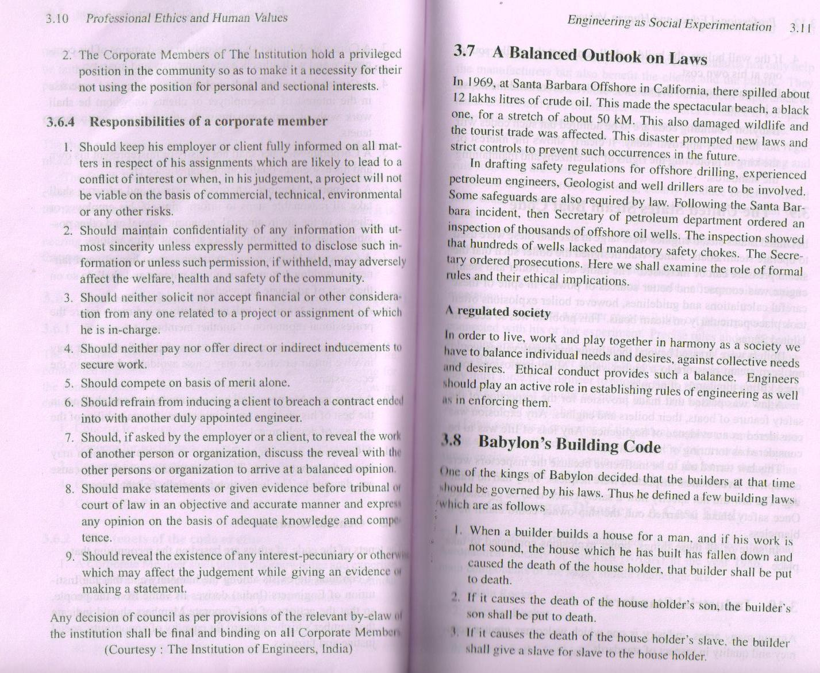

Slide 17
A BALANCED OUTLOOK ON LAWS
In order to live, work and play together in harmony as a society we have to balance individual needs and desires, against collective
Needs and desires. Ethical conduct provides such a balance. Engineers should play an active role in establishing rules of engineering as well as in enforcing them.

Slide 18
CHALENGER DISASTER CASE STUDY
Space shuttle launched by NASA(National Aeronautical Society of America)-January 28th,1986
No launching when the temperature is less than 53degrees
When planned the temperature was 36degrees F.
Within 75 seconds lift off, it had reached 16000 meters high-result engulfed in flames-Cabin crew fell into ocean and died.

Slide 19
SAFETY ISSUES
Government rejected the suggestion to have three stage rockets safety point of view. So no escape mechanism to crew
Astronauts were not informed about the problem of field joints
NASA’s scientists were unwilling to wait for proper weather conditions.-resulted in rupturing of the weak O-rings
Safety concern was ignored by the Management

Slide 20
Since Engineering is a Social Experimentation
ENGINEERS HAVE TO GIVE TOP PRIORITY FOR SAFETY FIRST AND THE SCHEDULE NEXT

Slide 21
THANK YOU

